Slide 1
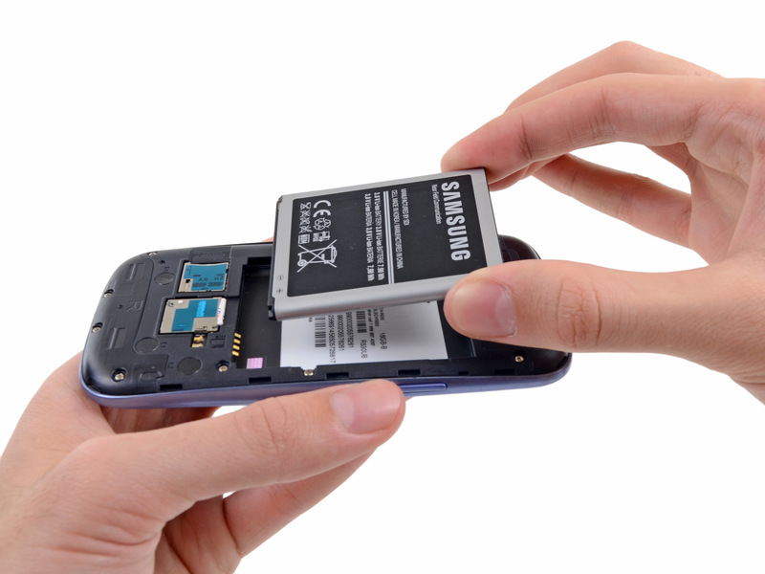
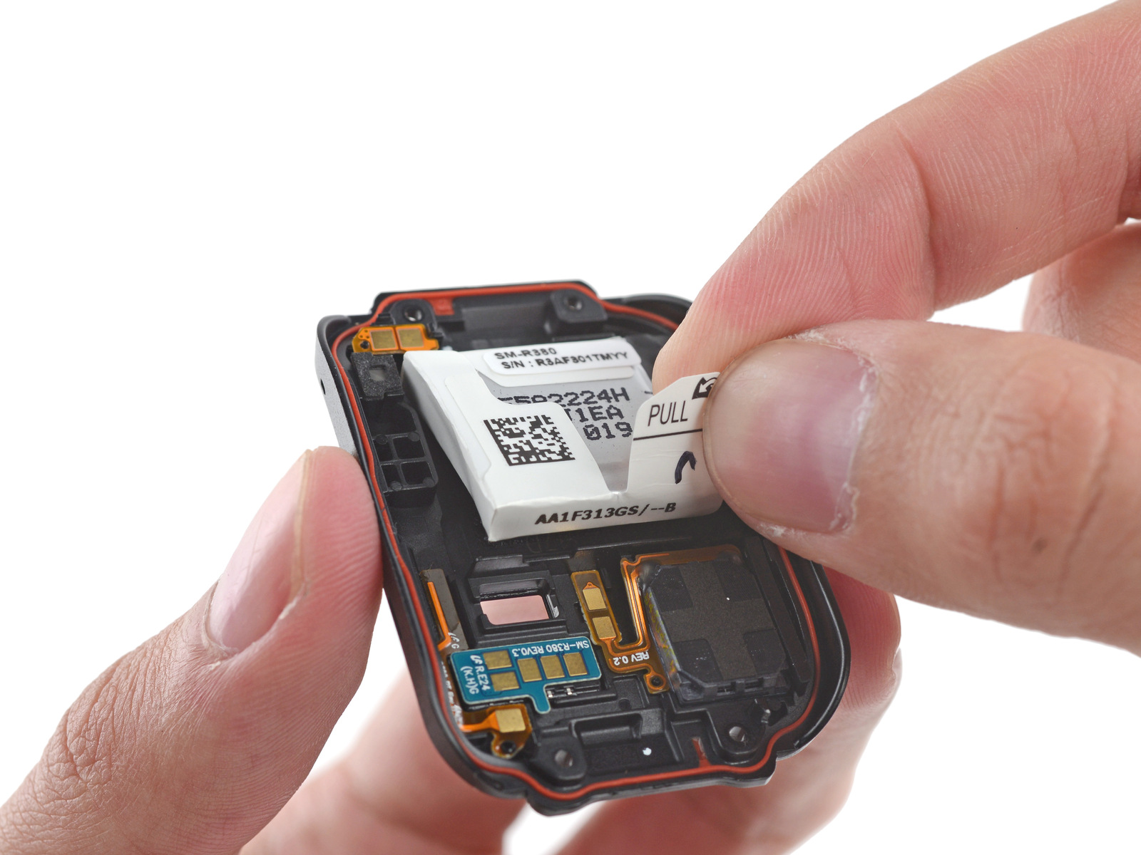
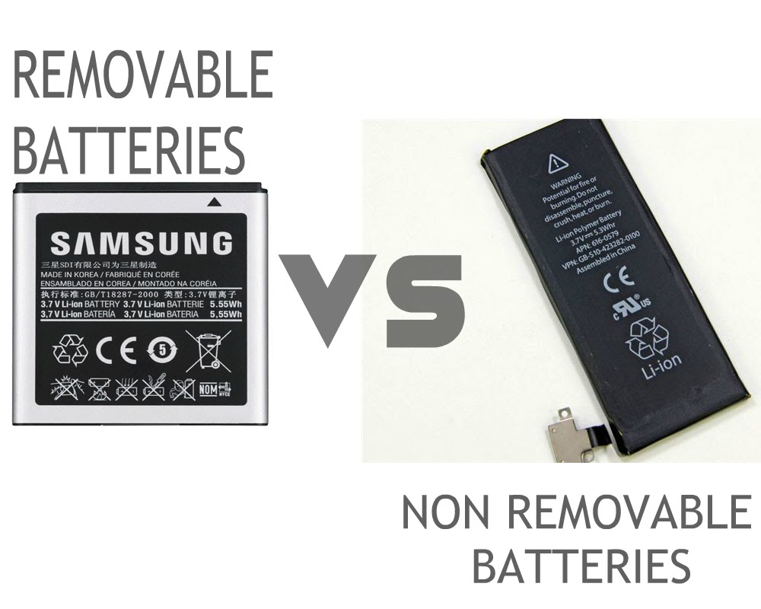
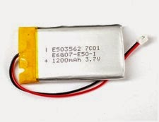
Battery
Replaceable
Built
-
In
Cable with connector
Spring loaded
On
-
Board
Cable with connector
Leaf spring
POGO pins

Slide 2
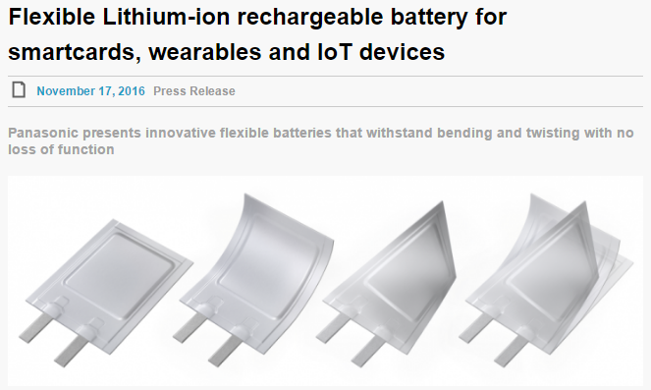

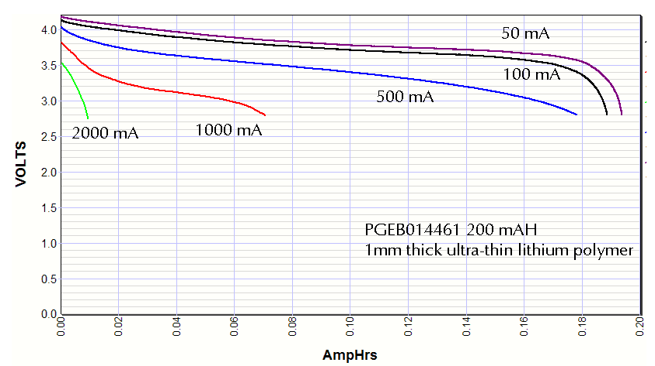

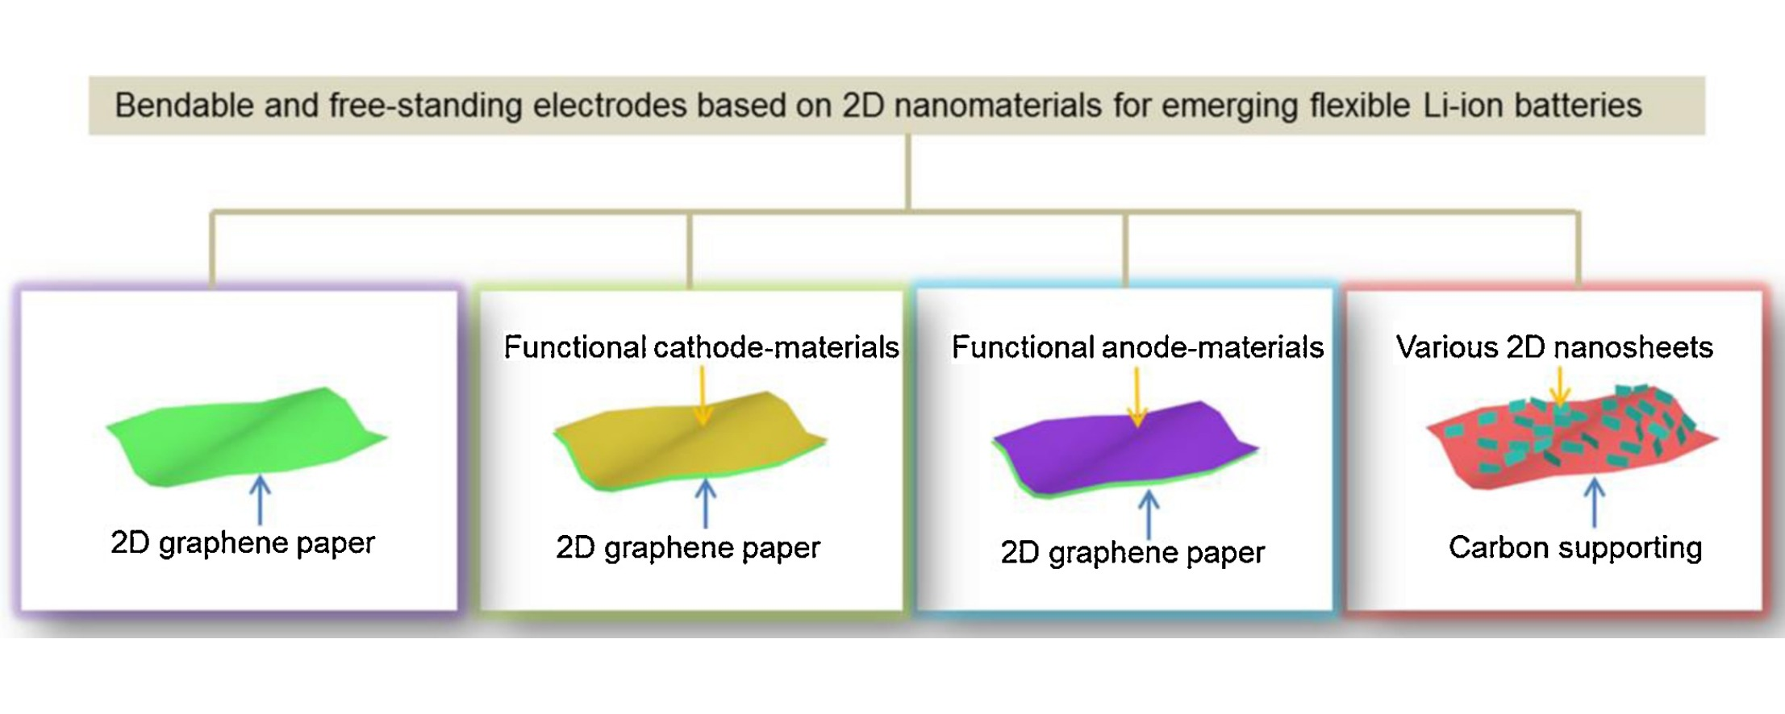
FLEXIBLE RECHARGEBLE BATTERY
Invisible Batteries for Wearables and the IoT

Slide 3
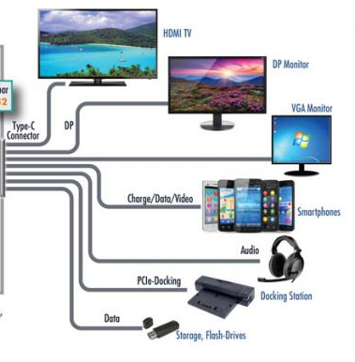
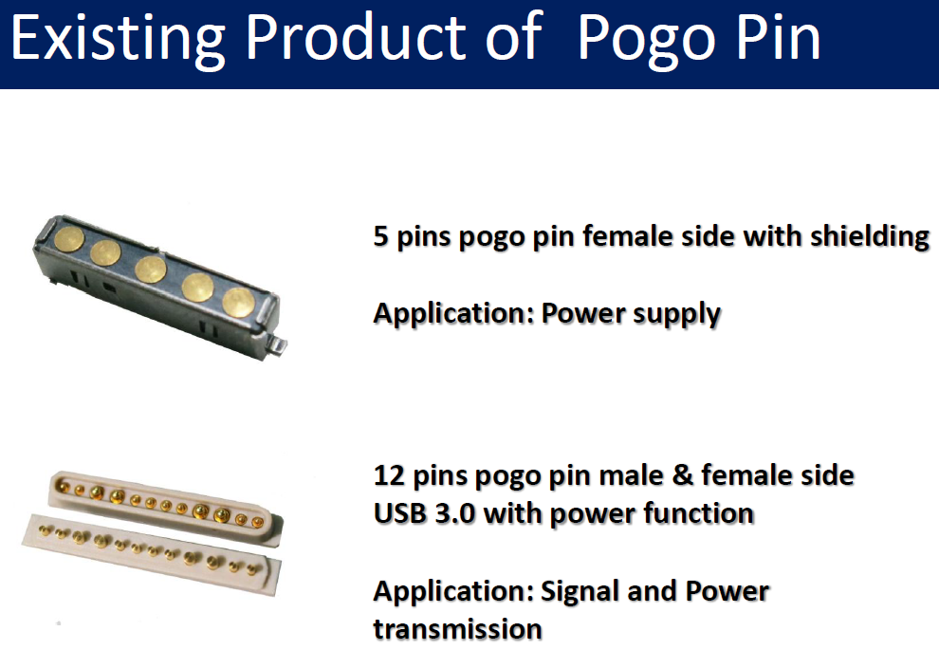
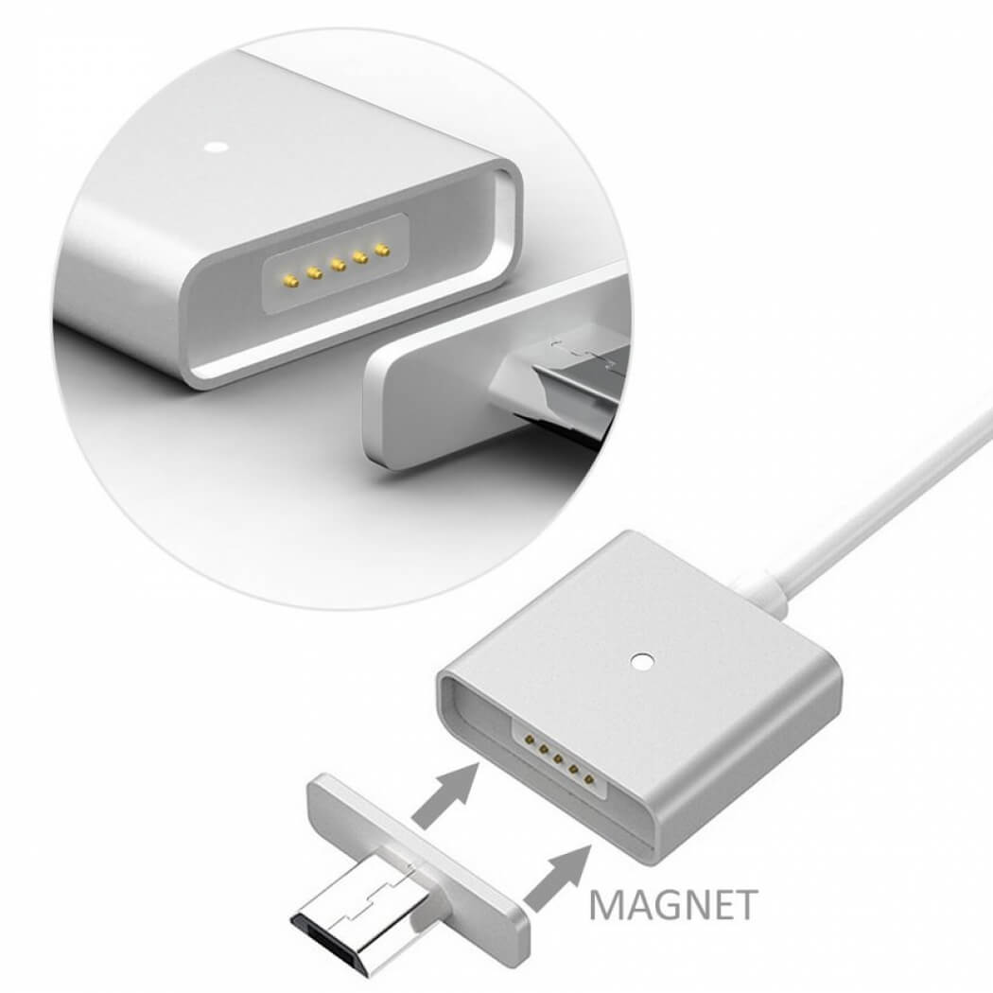
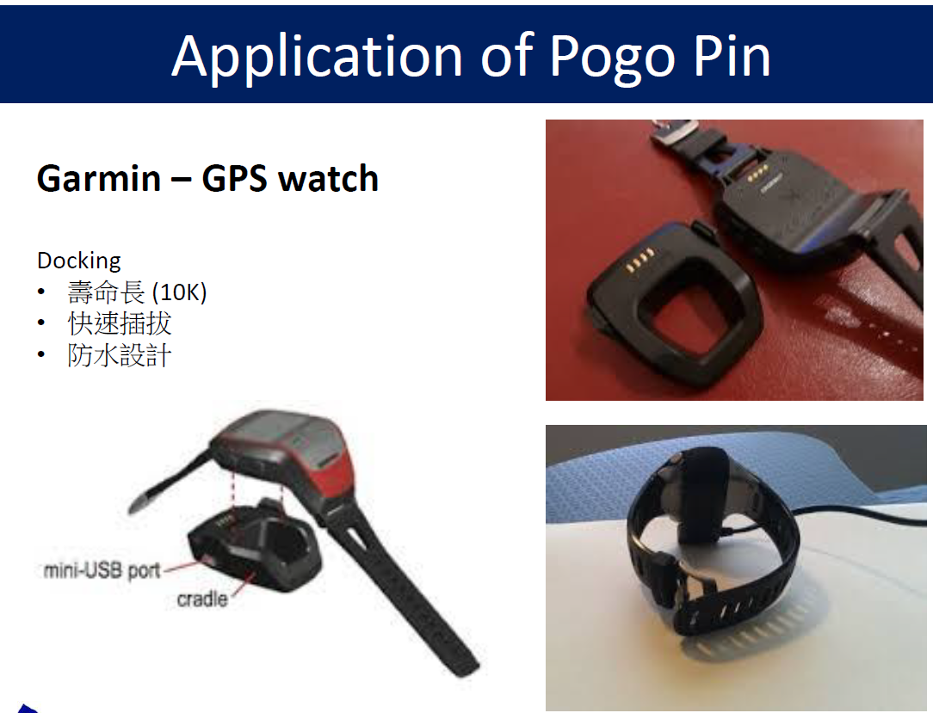
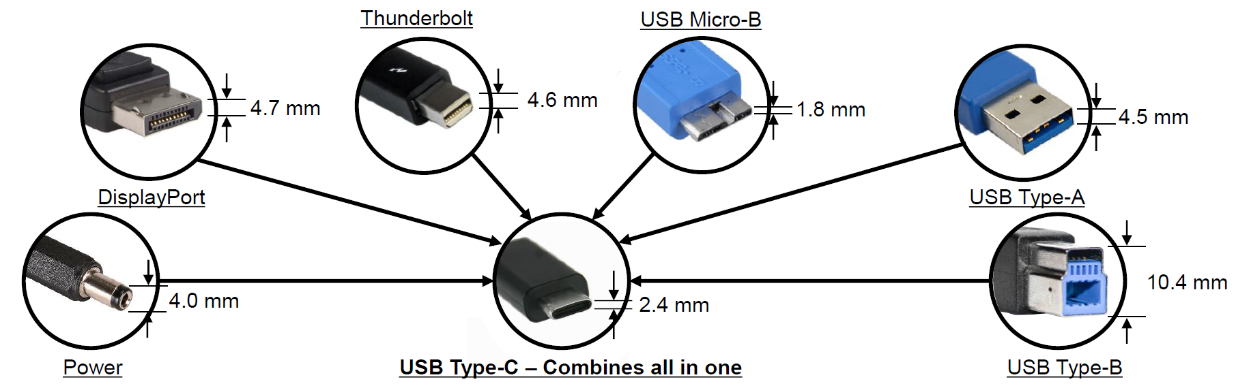
Connector
OLD standard
Audio adaptor
3
.
5
mm
3
pole
Audio adaptor
3
.
5
mm
4
2
pins connector
pole
Micro USB B
USB C
Spring loaded
POGO pins
Leaf spring
USB type C – Android port on smartphones

